Slide 1
JAVA
UNIT 5

Slide 2
Package
Package in Java is a mechanism to encapsulate a group of classes, sub packages and interfaces. Packages are used for:
Preventing naming conflicts. For example there can be two classes with name Employee in two packages, college.staff.cse.Employee and college.staff.ee.Employee
Making searching/locating and usage of classes, interfaces, enumerations and annotations easier

Slide 3
Package
Packages can be considered as data encapsulation (or data-hiding).
All we need to do is put related classes into packages. After that, we can simply write an import class from existing packages and use it in our program.
A package is a container of a group of related classes where some of the classes are accessible are exposed and others are kept for internal purpose.
We can reuse existing classes from the packages as many time as we need it in our program.

Slide 4
Package
Providing controlled access: protected and default have package level access control. A protected member is accessible by classes in the same package and its subclasses. A default member (without any access specifier) is accessible by classes in the same package only.

Slide 5
Access Protection in Packages
Packages are meant for encapsulating, it works as containers for classes and other sub packages. Class acts as containers for data and methods. There are four categories, provided by Java regarding the visibility of the class members between classes and packages:
Subclasses in the same package
Non-subclasses in the same package
Subclasses in different packages
Classes that are neither in the same package nor subclasses

Slide 6
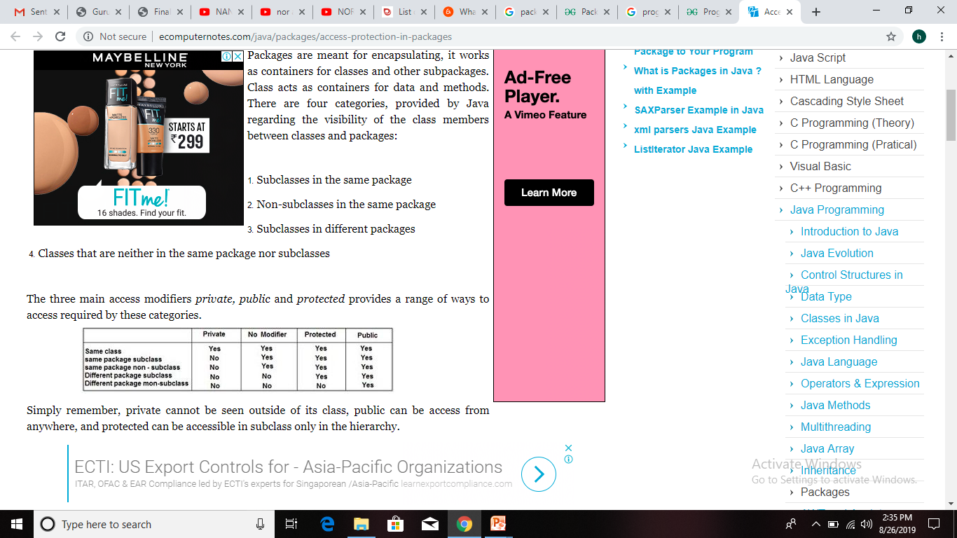
Access Protection in Packages

Slide 7
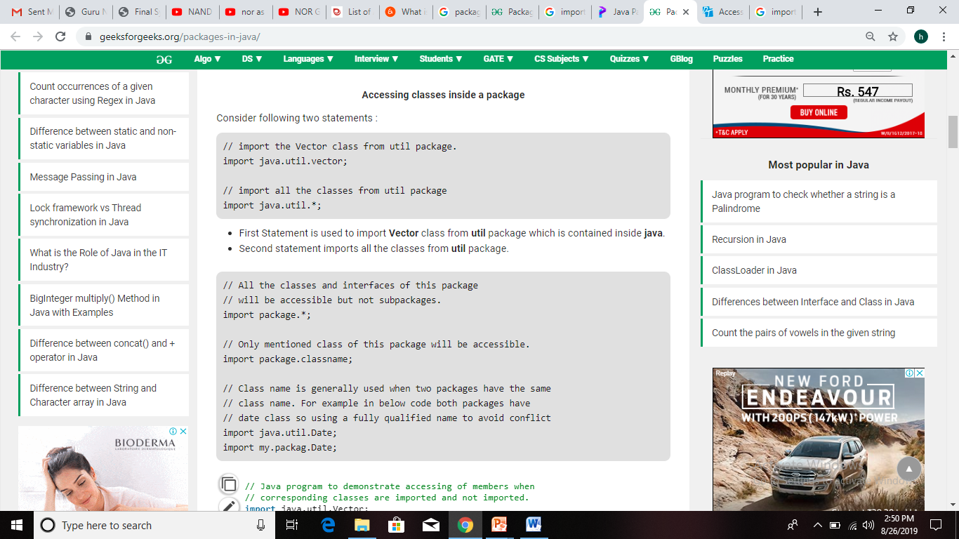
Importing packages

Slide 8
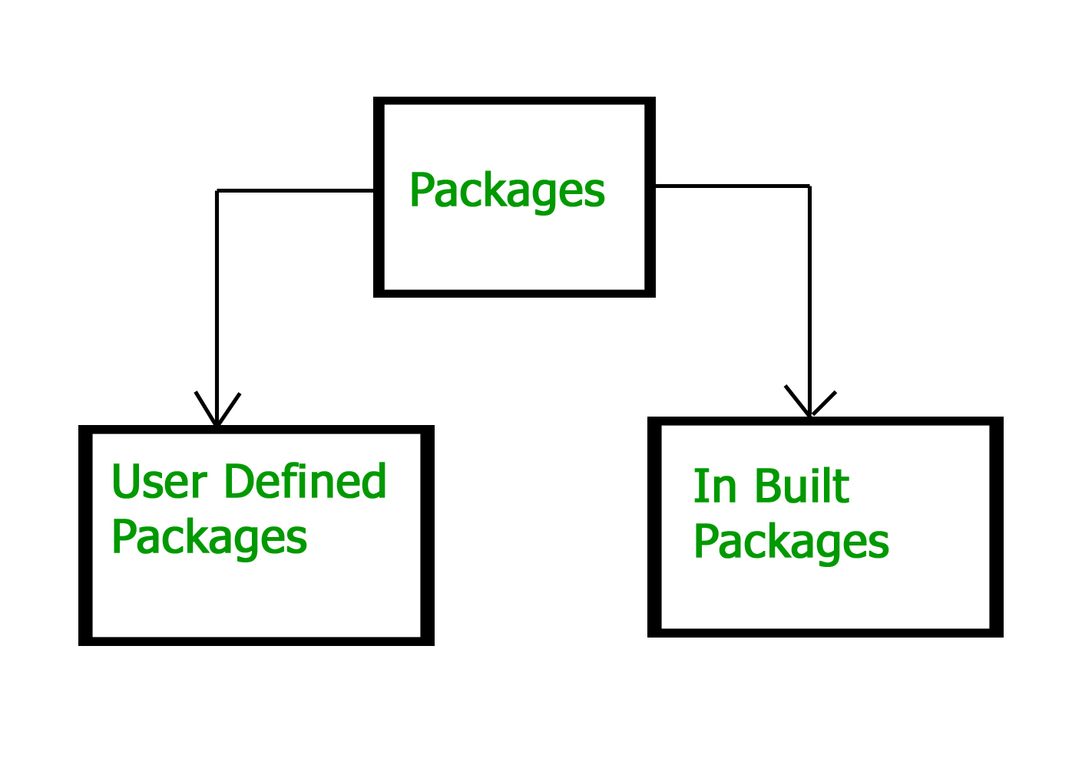
Types

Slide 9
Built-in Packages
These packages consist of a large number of classes which are a part of Java API. Some of the commonly used built-in packages are: 1) java.lang: Contains language support classes(e.g classes which defines primitive data types, math operations). This package is automatically imported. 2) java.io: Contains classed for supporting input / output operations. 3) java.util: Contains utility classes which implement data structures like Linked List, Dictionary and support ; for Date / Time operations. 4) java.applet: Contains classes for creating Applets. 5) java.awt: Contain classes for implementing the components for graphical user interfaces (like button , ;menus etc). 6) java.net: Contain classes for supporting networking operations.

Slide 10
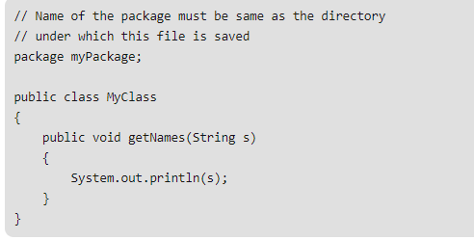
User-defined packages

Slide 11
Interface
Like a class, an interface can have methods and variables, but the methods declared in interface are by default abstract (only method signature, no body).
Interfaces specify what a class must do and not how. It is the blueprint of the class.
An Interface is about capabilities like a Player may be an interface and any class implementing Player must be able to (or must implement) move(). So it specifies a set of methods that the class has to implement.
If a class implements an interface and does not provide method bodies for all functions specified in the interface, then class must be declared abstract.

Slide 12
Interface
To declare an interface, use interface keyword. It is used to provide total abstraction. That means all the methods in interface are declared with empty body and are public and all fields are public, static and final by default.
A class that implement interface must implement all the methods declared in the interface. To implement interface use implements keyword.

Slide 13
Note
Why use interfaces when we have abstract classes?
The reason is, abstract classes may contain non-final and non-static variables, whereas variables in interface are final, public and static.

Slide 14
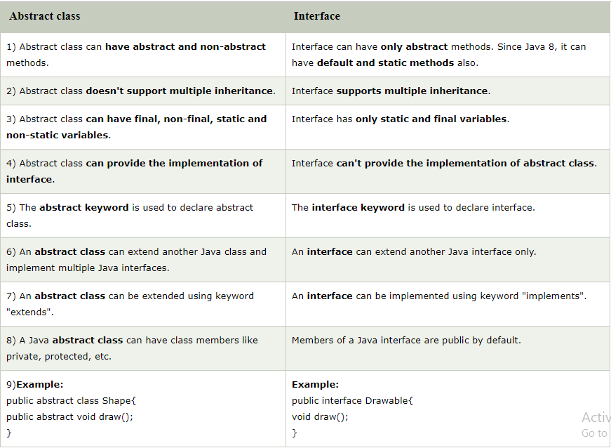

Slide 15
Why do we use interface ?
It is used to achieve total abstraction.
Since java does not support multiple inheritance in case of class, but by using interface it can achieve multiple inheritance .

